Slide 1
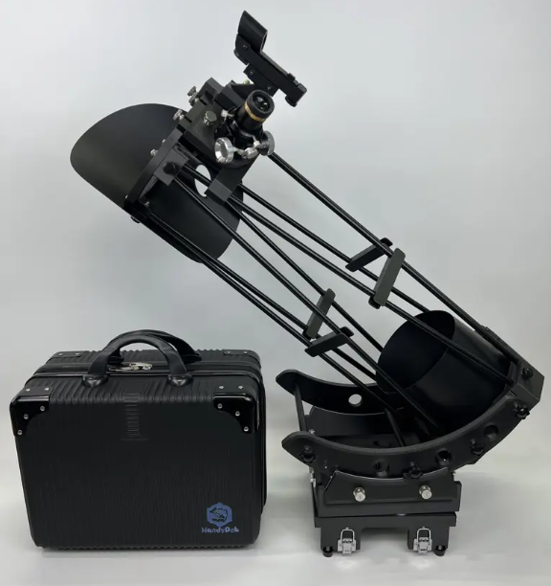

The HandyDob6 Telescope
Specifications
Price: $815
Telescope Type: Dobsonian
Aperture: 150mm (6”)
F-Ratio: 5
Mirror Precision: PV= ¼ λ or better. Manufacturer Spec is PV ¼ λ – 1/8 λ
Secondary Mirror: 38mm (with heater)
Body Weight: 4.2kg = 9.3lbs
Case Size: 400mm x 300mm x180mm = 15.8” x 11.9” x 7.1”
Case Weight with all accessories: 7.8kg = 17.2lbs
Focuser Height after assembly: 745mm = 30”

Slide 2
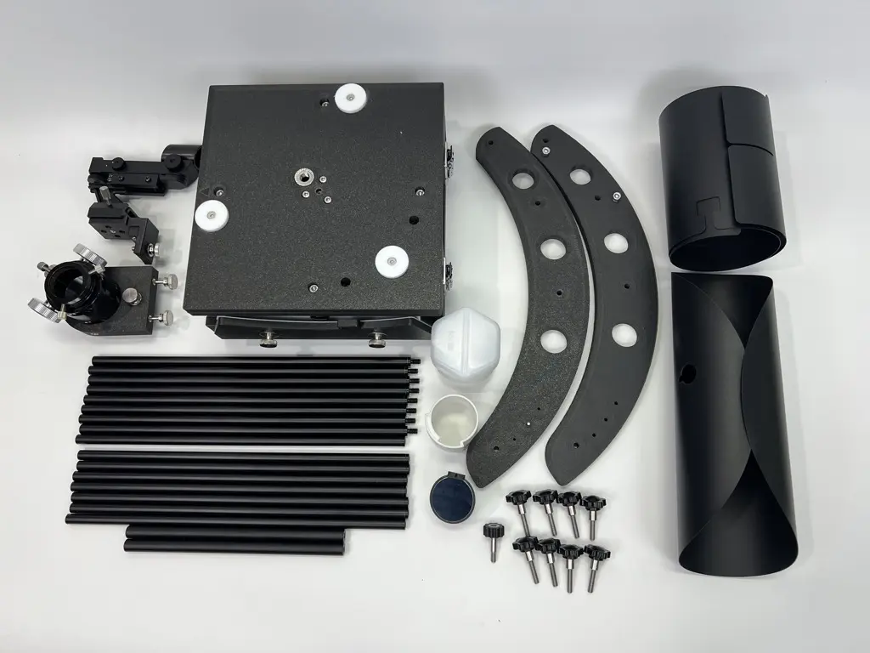
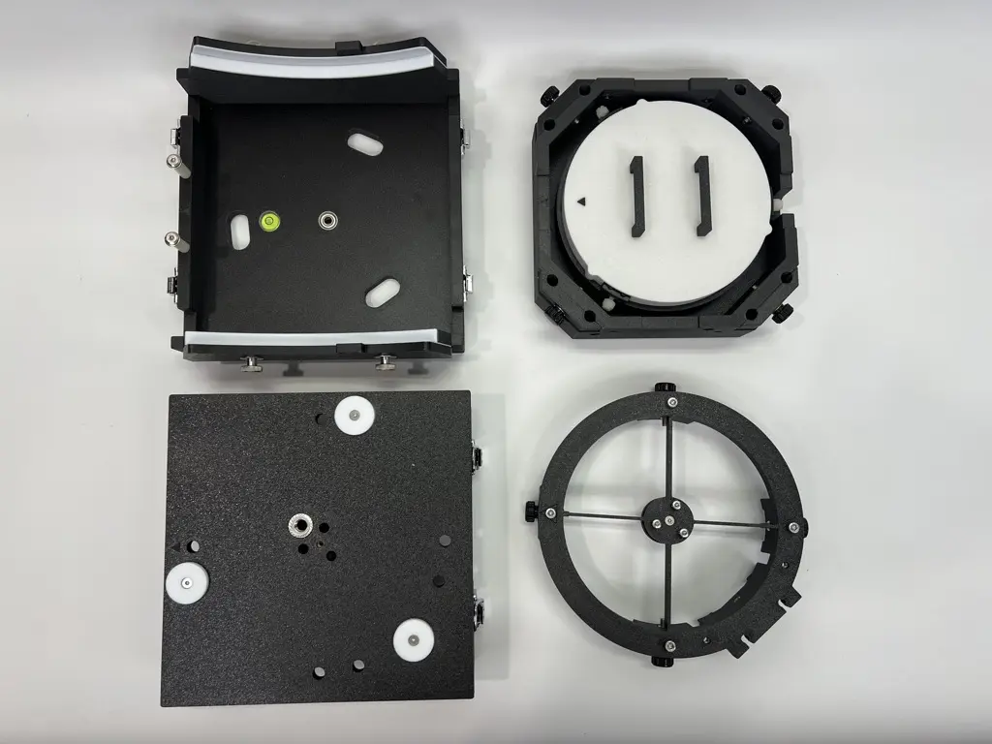
The HandyDob6 Telescope
Material
3D Print – PETG-CF (Carbon fiber infused)
Metal
Also Included
40mm USB cooling fan for primary mirror
Tripod Stability Plate
Red Dot finder
Built in Bubble Level
Truss light shroud

Slide 3
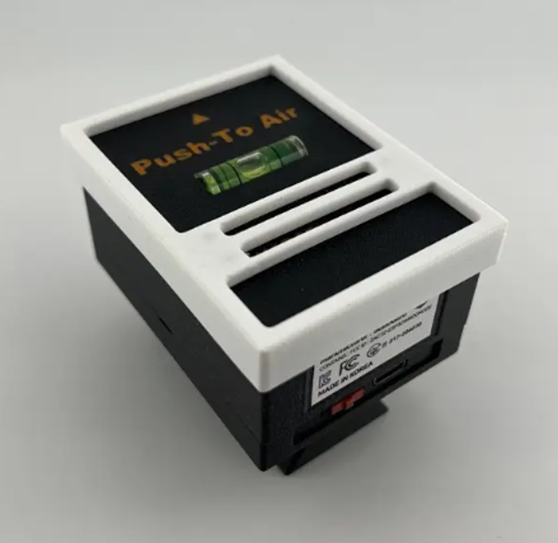
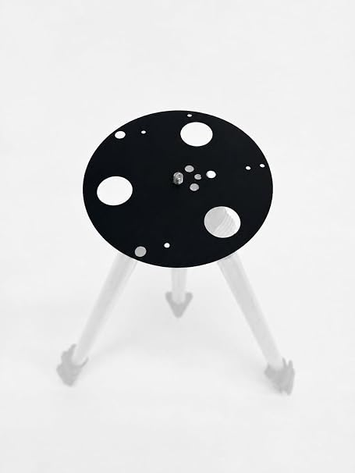
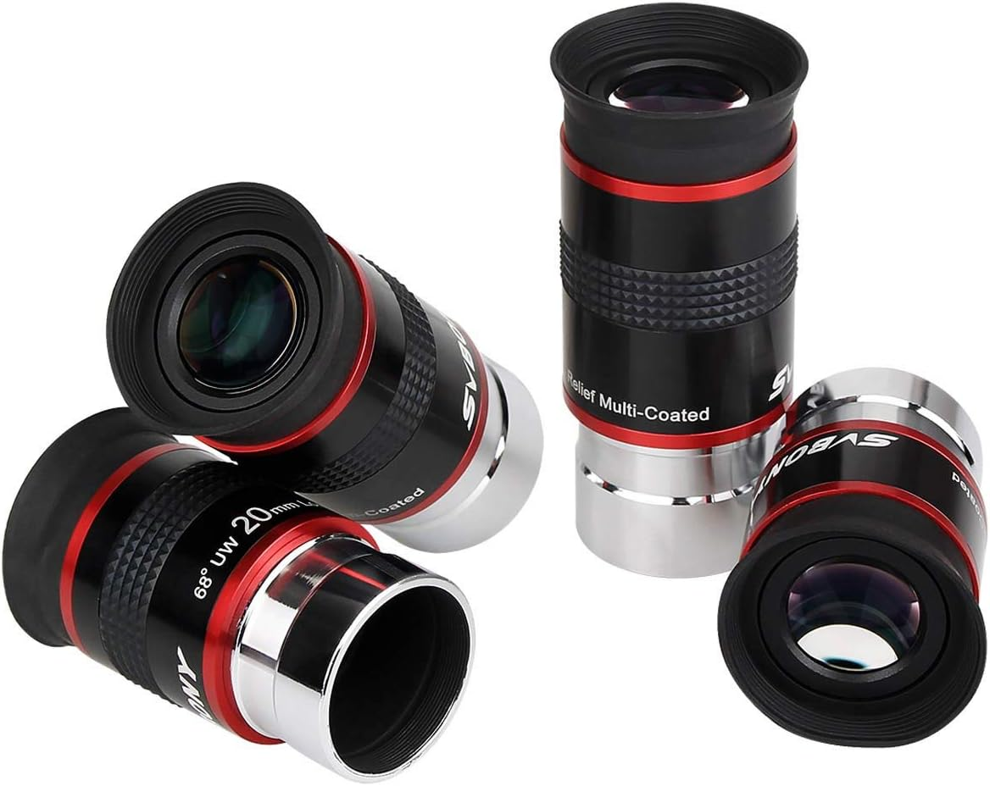
The HandyDob6 Telescope
Accessories and Upgrades
Eyepieces SVBONY Set (20, 15, 9, 6) = $115
Tripod with 3/8”
Optional: Push-To-Air $230
Optics Upgrade
  Orion Optics 150 f5 Primary Mirror, Ultra grade $400?
  Antares Secondary Mirror 1.52 Axis 1/20 Wave $125
3-D Prints
  Eyepiece Holder
  ZWO Mount Adapter

