Slide 1
A STARGAZER'S GUIDE
Observation Optimization
Matching your equipment and your sky to the right astronomical targets
James Yoder: www.ArtCentrics.com
Solar System
Point Sources
Extended Objects

Slide 2


Purpose of This Guide
This guide serves two kinds of observers.
Already Have Equipment
Shopping for Equipment
If you already own a telescope and observe mostly from one site, this guide identifies the astronomical targets best suited to your setup and sky conditions.
If you're looking to buy new gear, this guide helps you choose the right equipment for the type of targets you most want to observe.

Slide 3



Types of Objects
For our purposes, we will classify astronomical targets fall into three broad groups.
Solar System Objects
Point Source Objects
Extended Objects
Extremely bright, with an extended surface area.
Very small surface area — treated as point sources. Sizes measured in arcseconds (").
Significant surface area emitting light. Sizes measured in arcminutes (').
Examples Sun, Moon, Planets
Examples Carbon stars, double stars, small planetary nebulae
Examples Galaxies, globular clusters, large nebulae

Slide 4

Object Classifications
Object Type | Examples | Comments
Solar System Objects | Sun, Moon, Planets
Point Sources Carbon stars, Double / multiple stars Open clusters* Small planetary nebulae, asterisms* | Hynde's Crimson Star (CS) Albireo (DS) Double-Double (MS-4) Butterfly Cluster (OC) Ghost of Jupiter (PN) Stargate (AS)
Extended Objects Galaxies Globular clusters Large planetary nebulae* Dark nebulae Open clusters* Comets | Whirlpool Galaxy (G) Messier 10 (GC) Helix Nebula (PN) Pipe Nebula (DN)
* Open clusters and Planetary Nebulae may fall in either group depending on how they are treated.

Slide 5

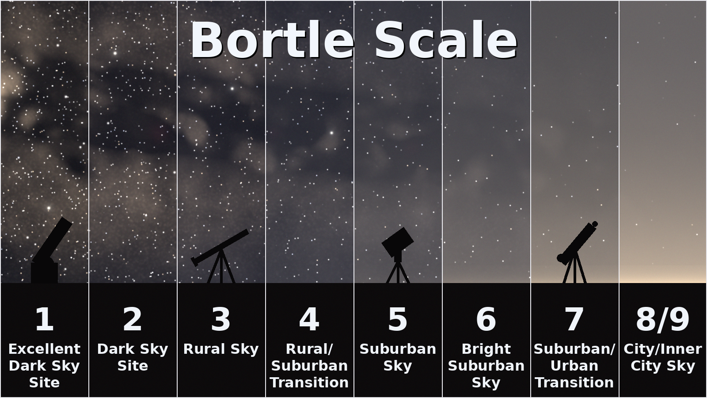
The Bortle Scale
Sky Background Glow
Sky glow is measured in units of mag/arcsec² .
For simplicity, most observers use the Bortle Scale, a scale that maps a range of SQM values from pristine dark skies to bright inner-city glow.

Slide 6

Surface Brightness & Contrast
Surface Brightness
What is Contrast?
Surface Brightness is defined as the total light output from an object(magnitude) divided by the apparent size of the object in arcseconds (mag/arcsec²).
Lower numbers = brighter object
This is a VERY rough, estimate assuming a uniform brightness over the area of the object. Real objects in brightness for difference areas of the object.
As an object shrinks, its surface brightness approaches its magnitude. For point sources like stars, magnitude alone describes it.
Visibility depends on the difference between an object's surface brightness and the background sky.
0.5 mag
Estimated minimum brightness difference needed to distinguish an object from the sky.

Slide 7

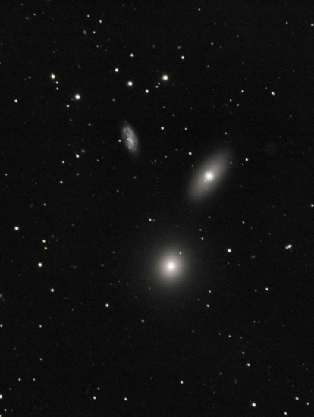
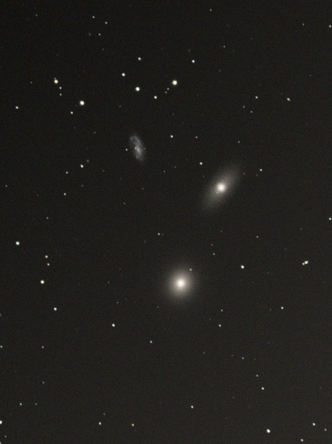
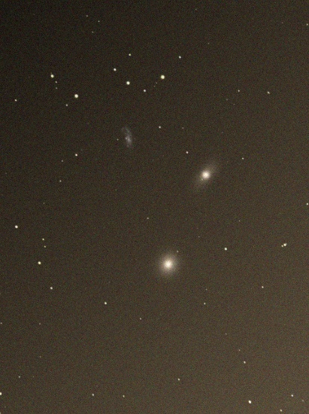
Why Your Sky Matters
Your local sky brightness limits what you can see — a galaxy dimmer than the sky will never be visible.
Bortle 1
Bortle 4
Bortle 7
Dark Sky
Suburban
City

Slide 8


Aperture Size
Aperture drives two key capabilities of your telescope.
Resolution
Light Gathering Power
The ability to see finer detail and split close multiple-star systems. Larger apertures help — up to a point. Around 9.25" with good optics. After that the atmosphere becomes the limiting factor, so more aperture won’t help resolve fine details on the Moon and planets or split doubles.
Aperture size directly impacts how bright objects appear. There is no practical limit to the benefit for increasing aperture size. Bigger is always better when it comes to seeing dim deep sky objects.

Slide 9



Mounts
Mounts don't change what you can see — but sometime the determine if you can find it.
Darker Skies — Star-Hopping
City Skies — Go-To / Push-To
At Bortle 4 or better, skies are dark enough to star-hop to targets with good success once you learn the technique. A manual mount is perfectly acceptable.
As Bortle class rises, star-hopping gets progressively harder. At Bortle 7 it's nearly impossible even for experienced astronomers to star-hop. In-city mandates a Go-To or Push-To mount for many if not most objects.

Slide 10

Focal Ratio
Focal ratio (f-Ratio) sets a telescope's inherent magnification and shapes which targets it suits best.
Magnification = (telescope focal length) ÷ (eyepiece focal length) Higher f-ratios can reach the same magnification with lower FL eyepieces; very fast scopes may struggle to find eyepieces with low enough FL to match slower scopes.
High f-Ratio
Low f-Ratio
Preferred for smaller targets
Better for larger, wide targets
Double / multiple star systems • Planetary and lunar detail • Globular clusters and galaxies
Open clusters • Large nebulae • Galaxy clusters • Asterisms

Slide 11

Resources To Help Your Observation Session
Free books and guides to help you plan your observing sessions.
SkyMaps.com
Yoder's Constellation Guides
skymaps.com
ArtCentrics.com · James Yoder
Download the free monthly Evening Sky Map.
Standalone guides for each constellation (50+ done) — A deep dive into popular and lesser-known objects in each constellation.
Star Hopper's Guide to the Universe
A New Catalog of Stellar Richfields
ArtCentrics.com · Jim Mazur
ArtCentrics.com · Bill Dellinges
A great star-hop book covering the best and most popular objects per constellation.
Tailored specifically for binocular astronomy.

Slide 12

Making a Decision
These are guidelines, not rules. There are always exceptions
M-42, both a nebula and open cluster, still looks great from the city in a small scope.
Using gear not recommended in the presentation can still be used; it just may not be optimal.
Experienced observers may disagree — make your own judgement from your experience.
Already Own a Telescope
Looking for a Telescope
Find the row matching your sky conditions and telescope design, then review the target types in that row.
Find the telescope design matching the sky conditions and target types you most want to observe.

Slide 13
Lookup Table
Sky Conditions | Astronomical Target Types | Optimal Telescope Designs
Darker Site (Bortle 1-4) | Solar System, Double/Multiple Stars, Small Planetary Nebulae | High f-Ratio Telescopes Maksutov-Cassegrain (best), Schmidt-Cassegrain, Dobsonian
Darker Site (Bortle 1-4) Increasing aperture always helps | Galaxies, Nebulae, Dark Nebulae, Large Planetary Nebulae, Open & Globular Clusters | Large Aperture Telescopes Dobsonian (best), Schmidt-Cassegrain
Darker Site (Bortle 1-4) Increasing aperture always helps | Dark Nebulae, Large Planetary Nebulae, Open Clusters | Low f-Ratio Telescopes Refractors, Dobsonian, Binoculars, Schmidt-Cassegrain
City Viewing (Bortle 5-8) Aperture can’t help | Galaxies, Nebulae, Dark Nebulae, Large Planetary Nebulae, Open & Globular Clusters | No point trying to view most of these objects in the city
City Viewing (Bortle 5-8) Larger apertures matter less | Solar System, Double/Multiple Stars, Small Planetary Nebulae, Open Clusters | High f-Ratio Telescopes Maksutov-Cassegrain (best), Schmidt-Cassegrain, Dobsonian

Slide 14
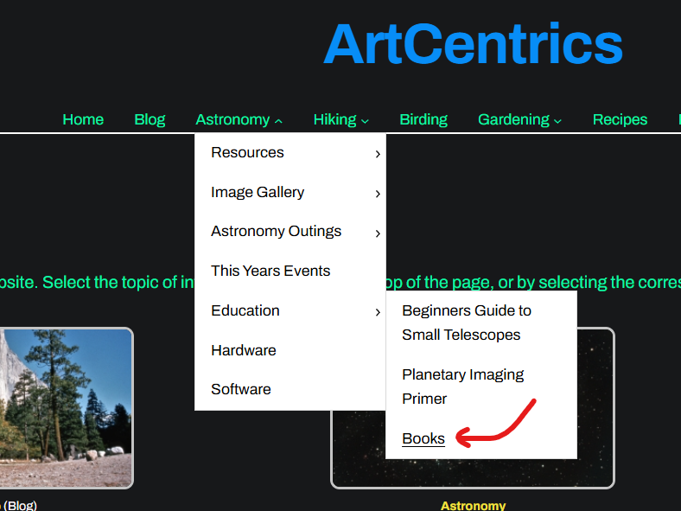
Visit My Website: ArtCentrics.com
Download and print the books and guides.

