Slide 1
Dark Nebulae:
Galactic playground for cosmic dust bunnies
What a dark nebula is
How big they get
A cold cloud of gas and dust dense enough to block the stars and bright nebulae behind it. We see it in silhouette, as a starless patch in a rich star field.
Example | Kind | Apparent size
B68 (Oph) | Bok globule | 4′
B86 (Sgr) | Compact cloud | 5′
B92 (Sgr) | Dark spot | 15′ × 9′
B78 (Oph) | Pipe Nebula bowl | about 3°
Coalsack (Cru) | Naked-eye cloud | about 7° × 5°
Great Rift | Cloud complex | Cygnus to Centaurus
Mostly molecular hydrogen; the tiny dust grains, about 1% of the mass, do the blocking.
Dust dims blue light more than red, so stars seen through thin edges look reddened.
Only a few degrees above absolute zero; the densest cores collapse into new stars.
Physically: from about half a light-year to complexes 100+ light-years across.
Apparent sizes for B-objects from Barnard's 1927 catalogue · 1 / 4
Notes:
Start with the idea that a dark nebula is not an absence of stars but a curtain in front of them. Barnard himself first assumed these were true holes in the star field, and only slowly came to accept they were obscuring clouds. The size table runs from the smallest objects that suit a medium telescope at moderate power (B68, B86) up to objects best seen with binoculars or the naked eye (the Pipe, the Coalsack, the Great Rift). The Coalsack is a southern object, not visible from Arizona; it is included only as a scale reference. Point out that the physical figure for B68 comes from infrared studies of the globule, and that the largest complexes are part of the giant molecular clouds that line the plane of the galaxy.

Slide 2
From "holes in the sky" to catalogues
Barnard catalogue
Lynds Dark Nebulae (LDN)
E. E. Barnard photographed the Milky Way with wide-field lenses at Lick and Yerkes. He listed 182 dark objects in 1919; his 1927 Photographic Atlas, finished after his death by Mary Calvert and Edwin Frost, lists 349.
Beverly Lynds catalogued 1,802 dark clouds in 1962 from the Palomar Sky Survey plates, north of −33°. Each gets an opacity class from 1 (faintest) to 6 (darkest), the observer's best guide to visibility.
1780s
1889–1919
1923
1930
1947
Herschel reportedly calls a starless patch "a hole in the sky."
Barnard's plates convince him these are clouds.
Max Wolf's star counts measure a cloud's absorption.
Trumpler shows dust dims starlight galaxy-wide.
Bart Bok proposes globules as stars in the making.
Dark nebulae · 2 / 4
Notes:
Barnard used short-focus portrait lenses, the Willard lens at Lick in the 1890s and later the Bruce telescope from Yerkes, because only wide fields show a dark cloud against its surroundings. Numbers 52 and 172 were dropped as duplicates in the 1927 edition, and 176 to 200 were never used because the second list began at 201. That is why the catalogue reaches B370 but has 349 entries. Lynds worked from the POSS prints, recording each cloud's position, area and opacity; the 1–6 scale is the one most observing guides quote. Cultural note for the audience: long before telescopes, the Inca named dark-cloud constellations in the Milky Way, and Aboriginal Australians saw the Emu in the Sky outlined by the dark lanes from the Coalsack through Scorpius. The Herschel "hole in the sky" line is a traditional attribution rather than a documented quote.

Slide 3
Technique
Allow 30+ minutes dark adaptation.
Only use red lights.
Aim for a field of view of 2x to 3x the cloud size.
Aim for an exit pupil of 5–7 mm if possible.
No filters, except for lanes in emission nebulae.
Watch the stars: look for a drop in star density.
Sweep slowly; motion reveals the edge.
Averted vision; compare with the next field.
Start with opacity 5–6; check a photo for shape.
Is the edge sharp? Is it blacker than the sky?
Seeing them at the eyepiece
Instruments
Sky conditions
7×50 or 10×50 binoculars for the Pipe and Great Rift.
80–120 mm f/4–f/6 rich-field scopes for 2–3° fields.
6–10” Scopes, low power, for small clouds.
Bortle 1–3: most Barnard objects in reach.
Bortle 4: opacity 5–6 clouds on rich star fields.
Bortle 5+: little beyond the Great Rift.
Moonless, transparent nights; target near the meridian.
Sky and equipment figures are rules of thumb, not hard limits · 3 / 4
Notes:
The key idea is framing. A dark nebula only exists by contrast, so the eyepiece must show plenty of star field around it; an object that fills the field disappears. That is why short focal lengths and wide true fields matter more than aperture for all but the smallest clouds. Filters dim the background stars along with everything else, so they hurt contrast; the exception is a dark lane silhouetted against an emission nebula, such as the Horsehead with an H-beta filter. On sky quality, transparency matters far more than seeing, because the task is to detect faint stars behind the cloud's edge. Summer Milky Way targets in Ophiuchus, Sagittarius, Scutum and Aquila hold most of the Barnard catalogue and are best caught near the meridian, when they are highest. For technique, gently moving the scope or tapping the tube helps the eye pick out a low-contrast boundary. Barnard's own test for a real dark object was whether it looked blacker than the surrounding sky itself.

Slide 4
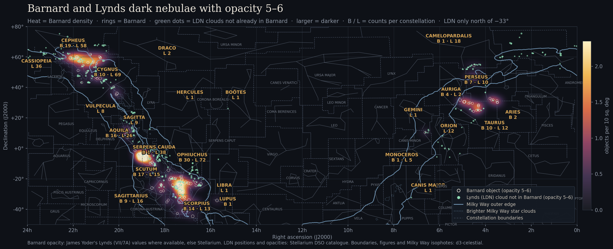
Where the darkest clouds are
568 unique clouds at opacity 5–6: 142 Barnard + 426 additional Lynds · 4 / 4
Notes:
This map shows every dark nebula at Lynds opacity 5 or 6, the ones most likely to be seen visually: 142 Barnard objects (rings) and 426 Lynds clouds that are not already in Barnard (green dots), 568 distinct clouds in all. Gold labels give the count per constellation, B for Barnard and L for Lynds. The glow shows where the Barnard objects cluster. Three things to point out. First, almost everything sits inside or on the edge of the Milky Way, because dark clouds are only visible against a rich star background. Second, the two hottest areas are the Ophiuchus and Scorpius region, home of the Pipe Nebula and the Snake (B72), and the Scutum star cloud; both are summer targets that ride fairly high from Arizona. Third, Cepheus stands out in the north around the IC 1396 field, and the Taurus and Perseus clouds give winter observers something to hunt. The Lynds survey stops at declination minus 33 degrees, so the far southern parts of Scorpius and Sagittarius have fewer green dots than they really should. Opacities come from Lynds (1962); Barnard values come from a Lynds cross-match of the Barnard catalogue where available, and from Stellarium otherwise.

