Slide 1
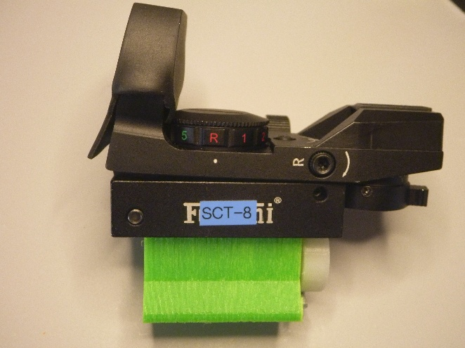
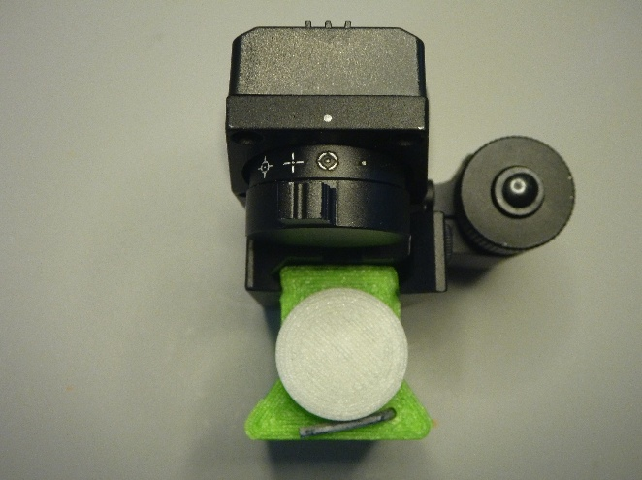
The Nearly Perfect Finderscope
A red-dot + laser finder, modified for astronomy
James Yoder
Notes:
The finished finder: a Feyachi red-dot/laser rifle sight with a 3D-printed dovetail adapter, re-worked dimming resistors, and magnetically stored Allen wrenches.

Slide 2
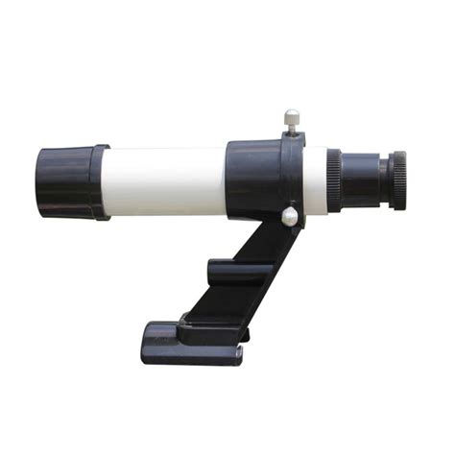
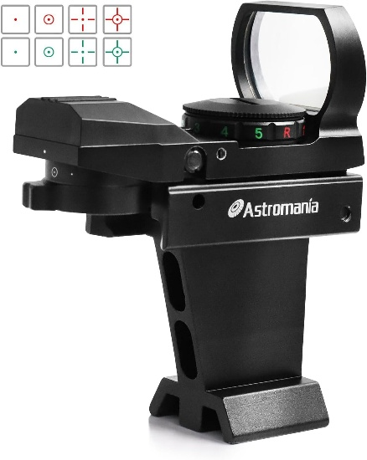
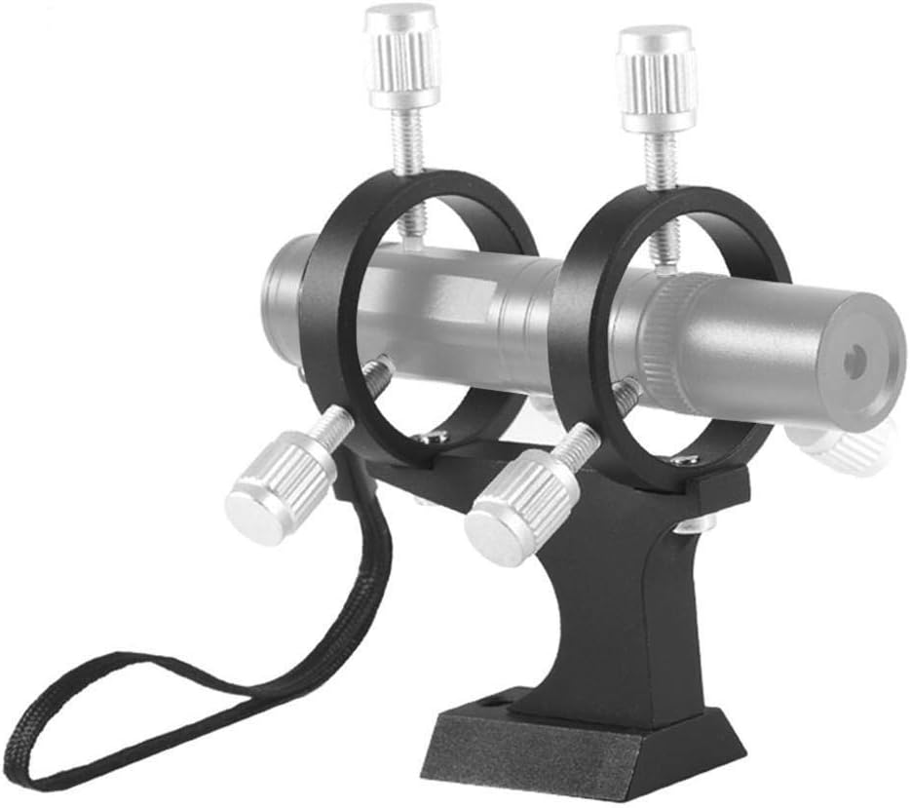
Three kinds of telescope finders
Classic finder
Red dot finder
Laser finder
A small telescope
Zero magnification
A beam on the sky
+ Can see dimmer stars
– Can flip or rotate the image
– Can be awkward to use
– Can require odd positions to look through
– Difficult to align
+ Intuitive to use
+ Easier to navigate with
– Often too bright for dim stars
– Can require odd positions to look through
– Requires a tool to align
+ Easy to use and navigate with
+ Fewer odd positions needed
+ Shows exactly where you are pointing
– Some astronomers find them offensive
– Can't be used until dark
– Can be difficult to align
– Needs a mounting solution
Notes:
There are three different categories of finders for telescopes: the classical finder that is really just a small telescope, the Red Dot Finder (there are many variations) that has a zero-magnification factor, and the laser finder.

Slide 3
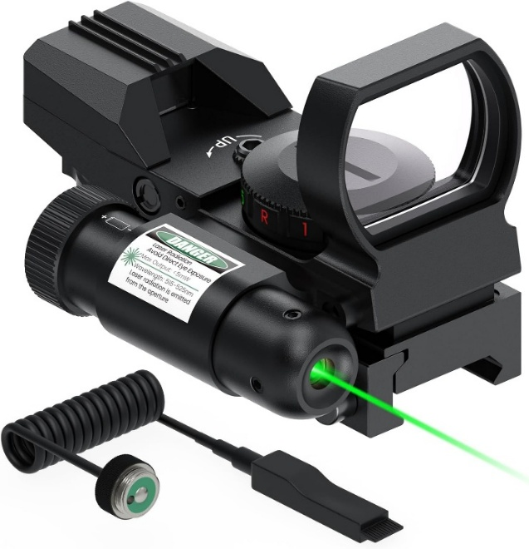
The search: one finder for day and night
Lasers are the easiest finders to use, but they can't be seen until it is quite dark. While looking for a replacement laser, I found a finder that combines a red-dot sight and a laser.
$42
Daytime
Evening
Night
Red dot + laser in one reasonably priced unit
A good solution for every phase of a session
Notes:
In my quest for the perfect finder, I have found that the laser is easiest for me to use; however, lasers cannot be seen and used until it is quite dark. Recently while looking for a replacement laser as a finder scope, I stumbled upon a finder that combined both the red-dot design and a laser for a reasonable price ($42). This seemed to be a good solution that would work for daytime, evening and night use.

Slide 4



Three issues to resolve
Red dot too bright
Mounting
Adjustment
The red dot is designed for daytime use. Even the lowest of its 5 brightness levels overwhelms any star you might target.
The finder is built to mount on a gun, not a telescope. It needs an adapter to fit a typical dovetail mount.
Earlier lasers could be adjusted by hand. Like most finders of this design, Allen wrenches are required to make adjustments to the finder.
Notes:
Red Dot was too bright: the red dot is designed to be used during the day. Although there are 5 levels of brightness that can be selected, even the lowest level overwhelms any star that might be targeted.
Mounting: the finder is designed to mount on a gun, not a telescope, so an adapter mount would need to be designed to make it compatible with a typical dovetail mount.
Adjustment: previous lasers used were able to be adjusted by hand; this model requires Allen wrenches for adjustment like most other finders of this design.

Slide 5

The solutions
Mounting & adjustment
A 3D-printed adapter puts the finder in a standard dovetail. The Allen wrenches can't be eliminated, so the mount stores them where they are easy to reach and hard to lose.
Red dot brightness
Replace the SMD resistors on the finder's circuit board with much higher values, giving far dimmer settings for dark-sky use.
Notes:
Mounting & Adjustment: designing and 3D printing an adapter for the finder so it goes in a dovetail was easy enough to do, and while I can't eliminate the need for the Allen wrenches, a solution was developed that stores the needed wrenches in the mount, so they are easily accessible and not easily lost.
Red Dot Brightness: replace various SMD resistors on the existing finder with new resistors as specified in the table.

Slide 6
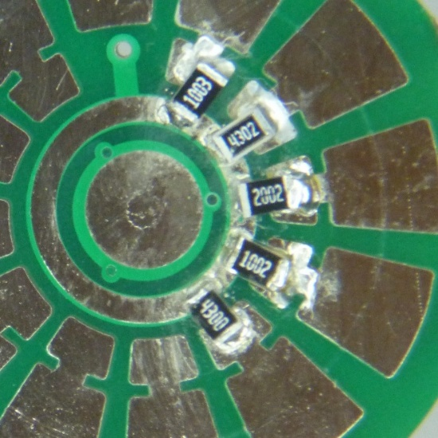
SMD resistor configuration
Position | Original | New | New setting
1 | 3,900 Ω | 300,000 Ω | Low intensity
2 | 2,400 Ω | 100,000 Ω | Dark sky
3 | 1,600 Ω | 51,000 Ω | Night use
4 | 590 Ω | 10,000 Ω | Dusk use
5 | 360 Ω | 430 Ω | Daytime use
Updated since the video
Use the values in this table, not the ones mentioned in the video. They give an even larger range of dim levels.
Position 1 is the dimmest setting; position 5 the brightest.
Notes:
NOTE: I have updated the resistors used in the new configuration since the video for this was made. Use the configuration in the chart, not what is mentioned in the video; this new configuration provides an even larger range of dim levels.

Slide 7
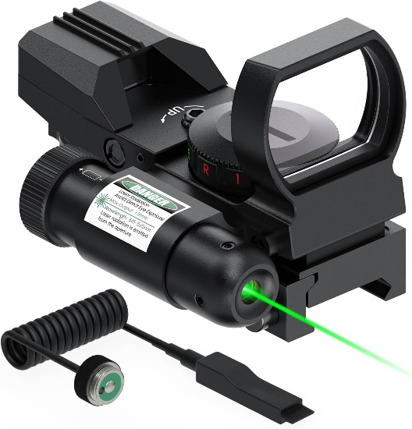
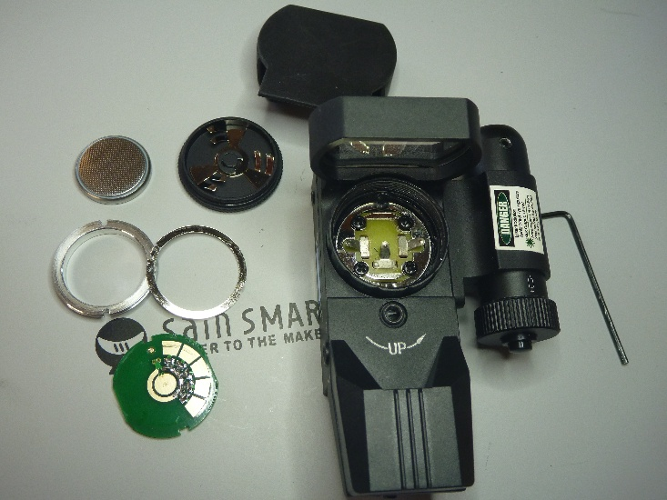
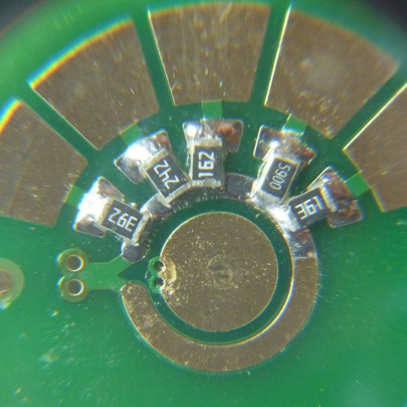

The modifications
Replace resistors
SMD resistors swapped for the new configuration
Dovetail mount
Designed and 3D printed
As purchased
Disassembled
Allen key storage
Keys cut to fit the mount, fitted with a head for easier use, and held in place by strong magnets in the dovetail mount
Original resistors
New resistors
Notes:
Replace Resistors: SMD resistors replaced as noted earlier.
Dovetail Mount: designed and 3D printed.
Allen Key Modifications: cut Allen keys to proper length to fit in dovetail mount. Addition of Allen key head for easier use. Allen keys are magnetically held in place by strong magnets added to the dovetail mount.

Slide 8

Result: a nearly perfect finder
Original range
New range
10×
680×
360 Ω to 3,900 Ω
430 Ω to 300,000 Ω
Usable from mid-day to dark sky. The 5 settings are bright enough for daytime, with enough dim levels that the dot won't overwhelm stars at night.
Wrenches always at hand. Allen wrenches are still needed to align the laser and finder with the OTA, but they're stored magnetically in the base of the mount.
Notes:
The resulting finder from this project is nearly a perfect finder for astronomical use. The 5 settings on the red-dot finder range in brightness to where the finder can be used in mid-day and has enough dim levels so that it will not overwhelm stars at night. The original range of this finder was from 360Ω to 3,900Ω, a range of 10x. The new finder range is from 430Ω to 300,000Ω, a range of 680x. While I was unable to eliminate the need for Allen wrenches to align the laser and the finder with the Optical Tube Assembly (OTA), the Allen wrenches are conveniently magnetically stored within the base of the finder mount so they are readily available and not easily lost.

Slide 9
Equipment used
Item | Price | Used for
Feyachi Reflex Sight for Rifle | $42 | The sight & laser combination
FNIRSI HS-03 Cordless Soldering Iron | $62 | Soldering SMD resistors
LRT 858D 700W Hot Air Rework Station | $38 | Makes removing SMD resistors much easier
1,500 pcs 0805 SMD Resistor Kit | $7 | Replacement resistors
Snap Ring Pliers | $10 | Removing the circuit retention ring
Sn42/Bi58 Lead-Free Solder Paste | $10 | Solder for replacement resistors
Liquid Flux | $6 | Soldering replacement resistors
Rhinocats 5 × 3 mm Magnets (60 pcs) | $6 | Magnetic holder for Allen wrenches
SUNLU PETG Filament | $25 | Only about 15 g needed for the mount
Digital Multimeter | $12 | Checking circuit resistance (optional)
CAIG DeoxIT Contact Cleaner | $14 | Cleanup (optional)
Artecho Neutral Glow Paint | $19 | Paint for small Allen wrench (optional)
SainSmart 2-in-1 Helping Hands | $68 | Work station (optional)
Notes:
The following equipment was used in designing and making this device. Most items can be easily substituted. Item names in the table are links to the products.

Slide 10






Hints and tricks
Retention ring
Board orientation
Removing resistors
Snap ring pliers fit its two slots (a tiny flat screwdriver works, with more effort). Note which way the ring faces.
Note how the board sits relative to the setting values so it goes back in the same way.
Use the hot air station and remove them all first. Record the resistor sequence before you start.
Soldering replacements
Multimeter
Testing
Try flux alone first; add solder paste sparingly. Pinch fine tweezers above the resistor and below the board to hold it.
Verify each resistor is soldered properly with a Multimeter. Without one, you'll have to reassemble the circuit to test it.
The two lowest settings are very dim. Test them in a dark closet, not a lit room.
Reference: How to Read SMD Resistor Values with Code Chart (identify ratings before removal)
Notes:
Circuit Board Retention Ring: has two slots that the snap ring pliers can be used to remove the retention ring. You may be able to use a very small flat head screwdriver to do this also, but it will be a bit more work getting it to rotate. Also take note how this retention ring is facing when in place.
Circuit Board Orientation: make sure to take note of the orientation of the circuit board relative to the setting values to make sure it is oriented the same when you put it back in the compartment.
SMD Resistor removal: using the Hot Air Rework Station, I remove all of the resistors before putting in the replacements. Make sure you keep track of what the sequence of resistors should be on the circuit board before starting the removal process.
Soldering replacement resistors: I have found the best technique for this is to first try to solder the resistors without addition of solder, just using liquid flux to see if the residual solder will be enough; if not, use solder paste (sparingly). I have also found the technique of using fine needle tweezers positioned above the resistor and below the circuit board (pinching them in position together) works best to keep the SMD resistor from moving around when soldering it.
Digital Multimeter: if you have one, use it to verify the SMD resistors are soldered properly; otherwise, you will need to place the circuit back in for testing.
Testing the Finder: the two lowest settings are very dim; you may not be able to see them in a normally lit room, so you may need to go to a dark closet for testing these two settings.

Slide 11
Postscript: Jimmy Ray's cheaper route
~$60
“
This kit has no 43 Ω, so I used 47 Ω. Careful not to swap the 47 Ω and 4.7K, or you get dim, dimmer, BRIGHT, dim, dimmer ;-)
All in, using a pencil iron and a small resistor kit
“
No hot air station? Lay the pencil iron tip alongside and across both ends of the resistor at once and it comes right off.
The resistor kit
Size 0805 SMD, $7 for 1,500 pcs
60 values (25 each), 0 Ω to 10 MΩ
±1% tolerance, 1/8 W
View on Amazon
“
Solder one end of each new resistor, then once all are placed, run the iron along the common terminal points.
“
Pay close attention on reassembly: it's easy to get things in backwards, or off 90°.
Notes:
After posting this project on the internet I received this response from one of our local astronomers. It makes a good point that you can do this project much cheaper than I indicate in the instructions. I wanted to provide full information on the equipment I used; Jimmy points out there are other options. (I did update my original instructions to match the resistor kit he uses.)
Resistor kit specs: 1500 pieces, total 60 values (25 pcs each), 0Ω to 10MΩ. Type 0805, surface mount (SMD/SMT), tolerance ±1%, power 1/8W (0.125W). Values: 0Ω 1Ω 2.2Ω 3.3Ω 4.7Ω 5.1Ω 10Ω 15Ω 22Ω 33Ω 47Ω 51Ω 62Ω 82Ω 100Ω 120Ω 150Ω 180Ω 200Ω 220Ω 240Ω 270Ω 300Ω 330Ω 470Ω 510Ω 560Ω 680Ω 820Ω 1kΩ 1.2kΩ 1.5kΩ 1.8kΩ 2kΩ 2.2kΩ 3kΩ 3.3kΩ 4.7kΩ 5.1kΩ 5.6kΩ 7.5kΩ 10kΩ 12kΩ 15kΩ 18kΩ 20kΩ 22kΩ 33kΩ 43kΩ 47kΩ 51kΩ 75kΩ 100kΩ 200kΩ 300kΩ 390kΩ 470kΩ 680kΩ 1MΩ 10MΩ.
Jimmy's closing: Easy and fun project! (All in, ~$60). Thanks again James, Jimmy Ray.

Slide 12





Gird your loins: the laser debate
Both sides have legitimate arguments, and everyone is entitled to their opinion. Don't bother trying to convince someone who is itching for a fight.
“They're illegal in many countries.”
True. Don't use them in those countries.
“A laser in the eye can cause damage.”
Class IIIa lasers (<5 mW) are a low but real risk. Never point a laser at anyone.
“Pointing a laser at an airplane is illegal.”
Yes. Never point a laser at a plane.
“Lasers cause problems for imagers.”
Our club keeps separate areas for imagers and observers to mitigate flashlights and lasers.
“Lasers are another distraction.”
With GoTo mounts, finders are mostly used to calibrate the mount or point out an object, so they're rarely on.
Notes:
The use of lasers for astronomy can be a hotly debated topic for astronomers. No doubt you will run across someone who may have a strong reaction to anyone using lasers in astronomy. Here are some pointers on what points may be made, and how to defuse a potential confrontation.

Slide 13



Bottom line: practice good laser etiquette
Set up at the edge
Use it only when needed
Never at people or planes
Locate yourself away from imagers, at the outer areas of an observing group.
Don't leave the laser on for extended periods of time.
Never point a laser at a person or an airplane.
Follow these guidelines and you shouldn't have any issues.
Notes:
Bottom Line: Practice good etiquette when using a laser. Locate yourself away from imagers and at the outer areas of an observing group. Only use the laser when you need it; don't leave it on for extended periods of time. Never point a laser at a person or airplane. Follow these guidelines and you shouldn't have any issues.

